Slide 1


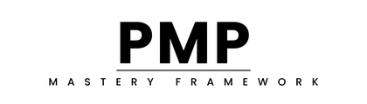
PMP MASTERY FRAMEWORK
Day 1:
Introduction & Foundations
PMP Exam Preparation Course
Notes:
Good morning/afternoon, everyone, and a very warm welcome to Day 1 of our PMP® Exam Preparation Course.
My name is [Your Name], and I am [Your Credentials - PMP, years of experience].
Over the next 13 weeks, we will embark on a structured journey to equip you with the knowledge and strategies you need to successfully pass the Project Management Professional (PMP)® exam.
I am genuinely excited to guide you through this process. This course is designed not just to help you pass the exam, but to truly understand project management at a professional level."

Slide 2
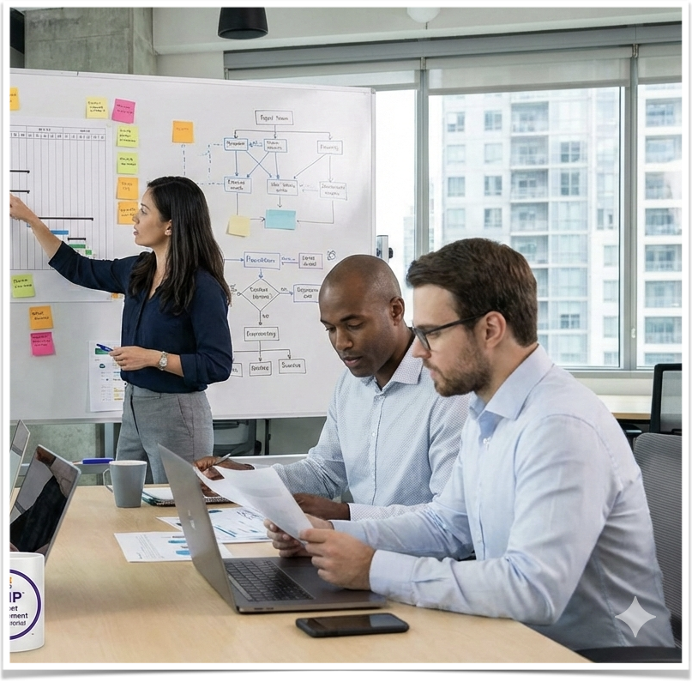
Welcome & Introductions
👋 Instructor Introduction
  Background and credentials
  PMP journey and experience
👥 Student Introductions
  Your name
  Current role
  Project management background
  Why you're pursuing PMP
Notes:
Welcome everyone to our PMP® Exam preparation journey.
As your instructor, my role is to guide you through the material and help you build the confidence to succeed.
Before we dive into the content, let's take a brief moment to welcome everyone and get a sense of the diverse experience we have in this group.
I'd like each of you to briefly share your name, your current role, your project management background, and what's motivating you to pursue your PMP certification.
This helps us understand each other and build our learning community.
Who would like to start?

Slide 3

Course Purpose & Focus
🎯 Primary Goal: Help you pass the PMP® exam
📋 ECO-Focused Approach
- Based on PMP Exam Content Outline (ECO)
- Not just the PMBOK® Guide
- Detailed review of domains, tasks, and enablers
✅ What You'll Get:
- Deep understanding of concepts
- Practical application strategies
- Exam-taking techniques
- Confidence to succeed
Notes:
The core purpose of this course is clear and direct: to equip you with everything you need to confidently pass the PMP exam.
A crucial point to understand from the outset is that the PMP exam is based on the PMP Exam Content Outline, or ECO.
While resources like the PMBOK Guide are essential references, the ECO is the actual blueprint for the exam.
This course is structured to guide you systematically through the ECO, providing a detailed review of each domain, task, and enabler.
We're not just going to read through material - we're going to deeply understand it, apply it, and practice it until you're completely ready.

Slide 4
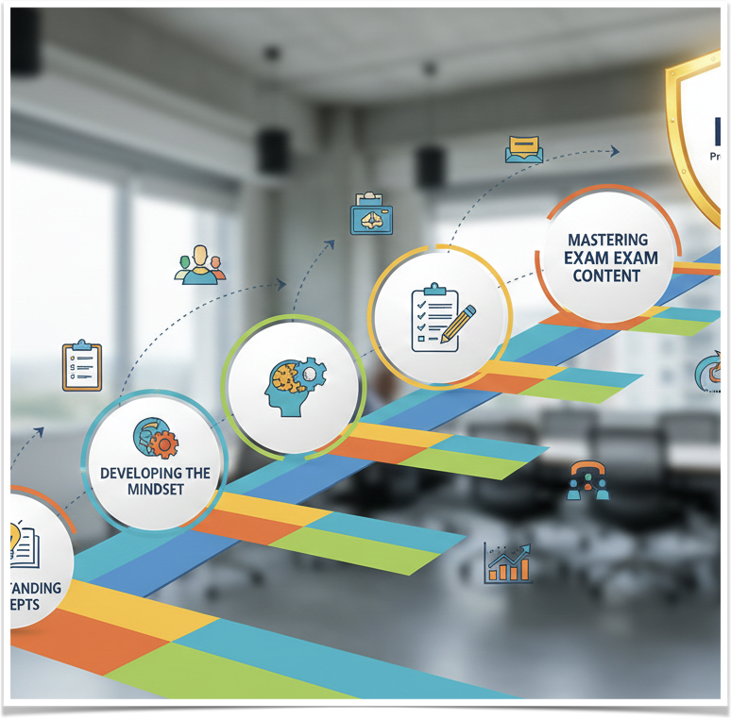
Key Learning Outcomes
By completing this course, you will be able to:
1. Understand the PMP Exam Structure (Domains & Weightings)
2. Master Core Concepts relevant to the exam
3. Identify key Tasks and Enablers within the ECO
4. Apply the PMP Mindset to scenarios
5. Analyze Exam Questions effectively
6. Develop A Personalized Study Strategy
7. Manage Exam Time efficiently
8. Boost Your Exam Confidence
Notes:
By actively engaging with this course, you will develop several key abilities crucial for passing the PMP exam.
You will gain a deep understanding of the PMP Exam Structure - the three domains and their weightings.
You'll master the core concepts that appear throughout the exam.
You'll learn to identify key Tasks and Enablers from the ECO.
Equally important is cultivating the PMP Mindset – the critical thinking approach needed for exam scenarios.
We will also cover strategies for analyzing exam questions, developing your personalized study strategy, managing your time during the exam, and most importantly, boosting your confidence so you walk into that testing center ready to succeed.

Slide 5
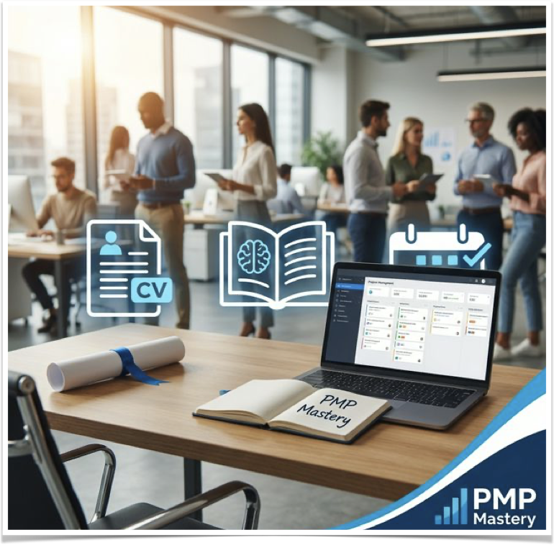
Course Requirements
✅ PMP Exam Eligibility
  Meet PMI's education and experience requirements
  Verify before starting
✅ Basic Project Management Knowledge
  Foundational understanding expected
  Familiarity with PM terminology
✅ Commitment to Study
  10-15 hours per week recommended
  Consistent daily practice
✅ Desire to Pass
  Strong motivation is key
  Clear career goals
Notes:
Before starting this course, it's important to ensure you meet the necessary requirements.
Firstly, you should meet PMI's eligibility requirements for the PMP exam. This includes specific education and experience criteria - please verify these on PMI.org if you haven't already.
Secondly, you should have basic project management knowledge. We'll build on fundamentals, but you should be familiar with basic PM terminology.
Crucially, success requires commitment to study. Plan for 10 to 15 hours per week of dedicated study time.
Finally, having a strong desire to pass will be a key driver for your motivation throughout this journey. What's your 'why'? Keep that front and center.

Slide 6
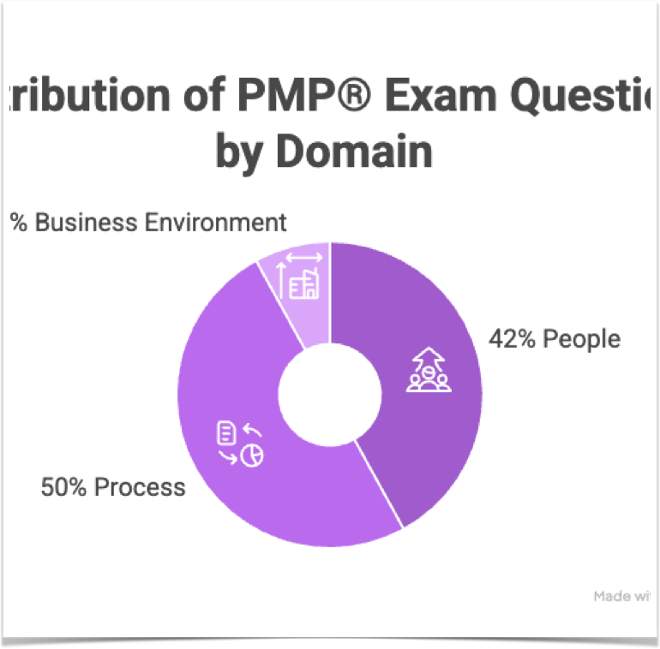
Exam Domain Breakdown
PMP® Exam Domains
🟢 PEOPLE: 42% (~76 questions)
- Managing and leading project teams
- Supporting team performance
- Empowering team members and stakeholders
- Managing conflict and fostering collaboration
🔵 PROCESS: 50% (~90 questions)
- Planning, executing, and closing projects
- Managing project changes and scope
- Optimizing project performance
- Integrating project planning activities
🟠 BUSINESS ENVIRONMENT: 8% (~14 questions)
- Planning and managing project compliance
- Evaluating and delivering project benefits
- Supporting organizational change
- Ensuring knowledge transfer for continuity
Notes:
The PMP exam is built around three domains from the Examination Content Outline. Let's break each one down.
The People domain represents 42% of the exam - approximately 76 questions.
This covers managing and leading teams, supporting performance, empowering stakeholders, and managing conflict.
Think of this as the 'soft skills' of project management, though they're anything but soft - they're critical.
The Process domain is the largest at 50% - about 90 questions.
This covers planning, executing, closing, managing changes, optimizing performance, and integrating activities.
This is your traditional project management processes.
The Business Environment domain is 8% - about 14 questions.
This covers compliance, benefits realization, organizational change, and knowledge transfer.
This is about understanding the bigger picture - how projects fit into organizational strategy.
Notice that Process and People together make up 92% of the exam. That's where we'll spend most of our time.

Slide 7
Exam Format & Logistics
📝 180 Questions Total
- Mix of all three domains
- Various question types
- Some are pretest (unscored)
⏱️ 230 Minutes (3 hours 50 minutes)
- Approximately 1.3 minutes per question
- Time management is critical
☕ Two 10-Minute Breaks
- After question 60 (optional)
- After question 120 (optional)
- Use them strategically
⚠️ **Important Notes:**
- Computer-based testing
- No materials allowed
- Calculator provided on screen
- Tutorial time doesn't count against you
Notes:
Let's talk about the exam format and logistics in detail.
You'll face 180 questions total, covering all three domains in a mixed format.
You'll see various question types, which we'll cover in a moment.
Here's something important: some questions are pretest questions that don't count toward your score. PMI uses them to test future exam questions. The challenge? You won't know which ones they are, so treat every question as if it counts.
You have 230 minutes - that's 3 hours and 50 minutes. Do the math: approximately 1.3 minutes per question. That sounds like a lot, but time flies when you're reading scenarios and analyzing options.
You get two optional 10-minute breaks - one after question 60 and another after question 120. I strongly recommend taking both breaks to refresh your mind.
The exam is computer-based, no materials are allowed, but you'll have an on-screen calculator.
The tutorial at the beginning doesn't count against your time, so use it to get comfortable with the interface.

Slide 8
Question Types You’ll Encounter
Question Types You'll Encounter
1️⃣ Multiple Choice (Most Common)
- Select ONE best answer from 4 options
- Usually scenario-based
- Strategy: Eliminate obviously wrong answers first
2️⃣ Multiple Response
- Select ALL correct answers (2-3)
- Question specifies how many to choose
- Strategy: Each option is true/false decision
3️⃣ Matching
- Connect items from two lists
- Common for processes, knowledge areas, tools
- Strategy: Start with ones you're certain about
4️⃣ Hotspot
- Click on specific areas of graphics/diagrams
- Often process flows or organizational charts
- Strategy: Understand the visual before clicking
5️⃣ Fill-in-the-Blank (Less Common)
- Type correct words or phrases
- Usually formulas or specific terminology
- Strategy: Spelling must be exact
Notes:
Let's dive deep into the five question types you'll encounter.
Multiple choice is the most common format. You'll see a scenario - often a paragraph or two - followed by a question and four answer options. Your job is to select the ONE best answer. These test your ability to apply the PMP mindset to real situations. Strategy: eliminate obviously wrong answers first, then choose the best remaining option.
Multiple response questions ask you to select ALL correct answers. The question will tell you how many - usually 2 or 3. Treat each option as a true/false decision.
Matching questions have you connect items from two lists - like matching processes to knowledge areas, or tools to techniques. Start with the ones you're absolutely certain about, then work through the rest.
Hotspot questions show you a diagram - maybe a process flow or organizational chart - and you click on the correct area. Make sure you understand the visual before clicking. Fill-in-the-blank questions are less common. You'll type specific terms or formulas. Spelling must be exact, so be careful. We'll practice all five types throughout this course."

Slide 9

Key Study Resources
Your Essential Study Resources
📋 ECO (Exam Content Outline)
What: Official exam blueprint from PMI
Why: Defines exactly what's tested
How: Structure your entire study plan around it
Download: Free from PMI.org
📚 PMBOK® Guide (7th Edition)
What: Project Management Body of Knowledge
Why: Detailed methodology and principles
How: Reference for understanding concepts
Access: Purchase or PMI member access
⚡ Agile Practice Guide
What: Agile and hybrid approaches
Why: Modern PM is agile-inclusive
How: Understand iterative and adaptive methods
Access: Often bundled with PMBOK
📦 Additional Resources (Provided)
1000+ practice questions
3 full-length simulated exams
Downloadable templates and checklists
Private online forum for support
Notes:
Let's talk about your essential study resources.
First and most important is the ECO - the Exam Content Outline. This is the official blueprint from PMI that defines exactly what domains, tasks, and enablers are tested. Download this free from PMI.org and structure your entire study plan around it. This is your north star.
Second is the PMBOK Guide, 7th edition. This is the Project Management Body of Knowledge - the detailed methodology and principles. Use this as your reference for understanding concepts in depth. You can purchase it or access it through PMI membership.
Third is the Agile Practice Guide. The modern PMP exam includes significant agile and hybrid content, so you need to understand iterative and adaptive methods. This is often bundled with the PMBOK Guide.
In addition to these core resources, this course provides over 1000 practice questions, three full-length simulated exams, downloadable templates and checklists, and access to our private online forum for support and community.
Together, these resources give you everything you need to succeed.

Slide 10
